Slide 1
Adopting AOP
Todd Kaufman

Slide 2
Outline
Howdy
Problem
AOP Intro
Needs for AOP
Solutions with AOP
Java
.NET
Ruby

Slide 3

Me
Beer Yoda
Architect
Manager
Java Studio
Dynamic Language Studio
.NET developer
Well kind of

Slide 4

You
Courtesy of a2gemma on flickr

Slide 5
Why is AOP Necessary?
Separation of Concerns = Necessary
Coupling = Bad
Cohesion = Good
Inheritance = Overused
Composition = Half Assed
Testing = Good
Notes:
Typical Base Class example
How to Add in Security

Slide 6
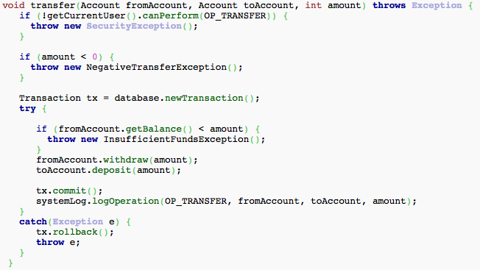
Who needs AOP?
<account example here />

Slide 7
AOP in the Making
Xerox PARC
AspectJ
AspectWerkz
AspectJ -> Eclipse
Spring AOP
AspectJ -> Spring
.NET Frameworks
AspectR
Aquarium

Slide 8

Terms
Courtesy of enter on flickr

Slide 9
Cross Cutting Concerns
Functions that span domain and business models

Slide 10
Aspect
A modularity construct that incorporates Pointcuts and Advice

Slide 11
Pointcut
A “query” over all Join Points

Slide 12
JoinPoint
A single execution point

Slide 13
Advice
Code execution to be performed in relation to a join point

Slide 14
Introduction
New methods or variables for an instance

Slide 15
Weaving
Linking aspects with other application types or objects to create an advised object.
Notes:
This can be done at compile time (using the AspectJ compiler, for example), load time, or at runtime. Spring AOP, like other pure Java AOP frameworks, performs weaving at runtime.

Slide 16
Advice Types
Before
After
After Throwing
After Normal
After Finally
Around
Constructor
Introduction

Slide 17

The AOP Triumverate
courtesy of zen on flickr

Slide 18

Security
Courtesy of Vagamundos on flickr
Notes:
Check the security context before allowing anyone to proceed with a method in the service layer
Throw a SecurityException if the user isn’t already authorized
Throw a SecurityException if a non-manager attempts to call a non-read only method
Mask the account number on a getAccount method if a non-supervisor is calling

Slide 19

Transactions and Sessions
Courtesy of Tom Morgan on flickr
Notes:
Start a transaction at the beginning of every method in the service layer
Commit the transaction at the end
Unless a SevereException is thrown, then roll it back
Don’t bother with a transaction if the method starts with Find, Read, Get, or Load
Hibernate’s Session object
OpenSessionInView pattern

Slide 20

Logging
Courtesy of Monster. on flickr
Notes:
Log Entered/Exited information on all method calls
Enable performance tracking for each method to determine bottlenecks in production
Log all method calls for any user that is not a manager

Slide 21

Caching
Courtesy of Bashed on flickr
Notes:
Not all systems within your control
Some are predictable
Some are slow
Some are unstable
Some already have clients accessing them

Slide 22
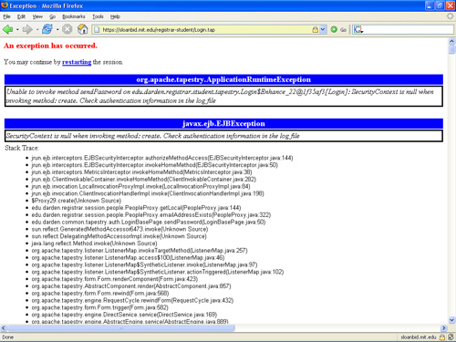
Exception Handling
Courtesy of YoavShapira on flickr
Notes:
All Severe Exceptions must be stored in an error queue
Any exception in the data access layer must be translated into a PersistenceException

Slide 23

Parameter Validation
Courtesy of williamhartz on flickr
Notes:
Typically done within a method
Can be done at the setter level
Sharing can be done via common validation method
Enforcement difficult

Slide 24

Policing Idiots
Courtesy of fabbio on flickr
Notes:
Log, don’t barf to system.out
Don’t call Session.close or Session.flush
StringBuffer
Naming

Slide 25
AOP Implementations
Proxy or Dynamic Proxy Based
Simple
Interfaces
Run time
Pre Compiler
Powerful
Complex
Compile time
Interpreted
Dynamic Language
Load time

Slide 26
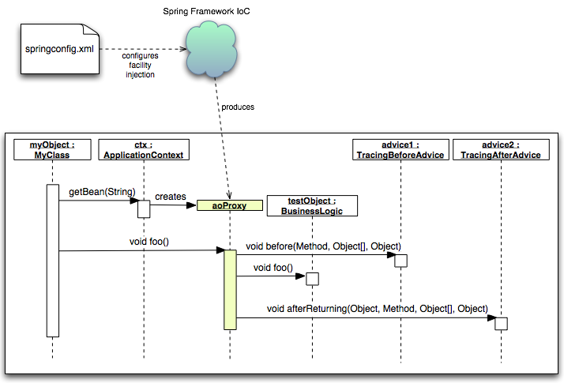
Proxy Based Interfaces

Slide 27
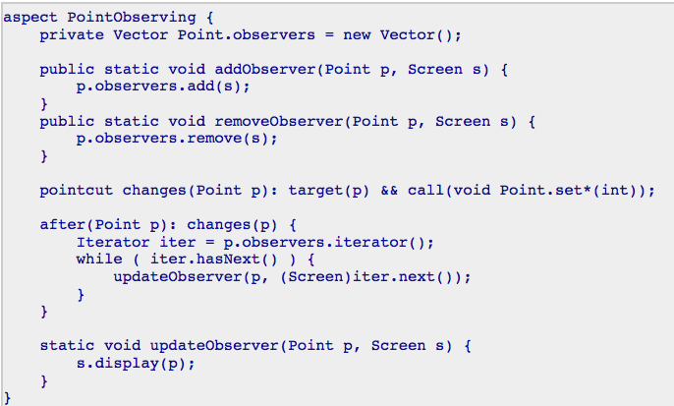
Full On AspectJ

Slide 28
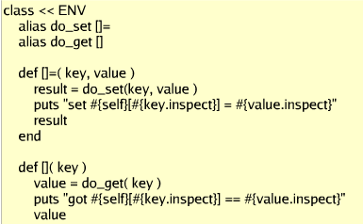
Interpreted Languages

Slide 29

Java AOP Options

Slide 30
Spring AOP
XML Based
CGLib
Before/After/Around
Interceptors

Slide 31
Spring AspectJ
Powerful
XML or @
Spans Naming
Introductions
Advice

Slide 32
AspectJ
Unique Needs
Rockstars Required
Document Thoroughly

Slide 33

.NET AOP Options

Slide 34
Policy Injection
Enterprise Library
Handlers:
Logging
Exception handling
Caching
Validation
Authorization
Performance
Annotation or Configuration Driven

Slide 35
Policy Injection Rules
MarshalByRefObject or interface
Public members only
Static selection
Handlers cannot maintain internal state

Slide 36
Castle Windsor – Aspect#
Interception
Attribute or Configuration Based
Aspect# Facility
Docs are sparse

Slide 37

Ruby AOP Options

Slide 38
Method Aliasing
Per Class or Module
Widely Used
175 uses in Rails
Metaprogramming != AOP

Slide 39
Aquarium
DSL Syntax
Work in Progress
Works with JRuby
Type and Name matching
Powerful REGEX

Slide 40
Summary
20%, not the 80%
Facilitates DDD
Favor Simplicity
Testing Mandatory
DI / AOP like PB&J
Java: Spring AOP then Spring AspectJ
Ruby: Method Aliasing then Aquarium
.NET: Not sure

Slide 41
Questions
toddkaufman@gmail.com
tkaufman@quicksolutions.com
Twitter: toddkaufman
MSN: todd.kaufman@live.com
AOL IM: tkauf5000
Office: 896-2031
Cell: 565-8132

